Slide 1
.NET
Unit 12
2160711
Introduction to Windows Presentation Foundation (WPF), Window Communication Foundation and its Application

Slide 2
GTU Questions
1 | Write a short note on WCF. | 3
2 | What is WPF? Explain briefly | 3

Slide 3
WCF
What is WCF (Windows Communication Foundation)?
It is a unified communication framework for distributed applications.
It defines common programming model and unified API for clients and services to send messages between each other.
Key Characteristics of WCF:
SOA Based programming model
Services are offered on End Point
Separates service hosting, endpoints and services.
Interoperability with non WCF Web Services due to SOAP messages
Implements many of the WS Standards
Extensibility:
WCF client / server can be configured to interoperate with REST, ATOM-feeds, plain XML or JSON messages (extensions for interfacing to any message-based service).
WCF

Slide 4
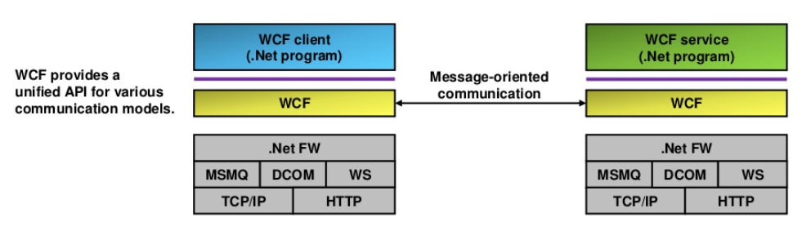
WCF
It provides a unified API to use various types of communication from an application.
WCF sits on top of the .Net Framework
WCF
WCF is service-oriented.
By separating the service interface (contract) from the transport protocol and message encoding, a (logical) service can be reused in different scenarios.
A developer is forced to specify a service interface on a logical level and then define how the service may be used (transport protocol, message encoding).

Slide 5
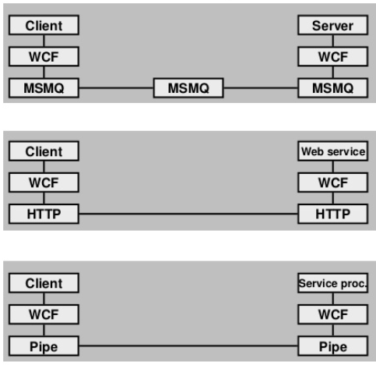
WCF
WCF is a generic communication framework.
WCF supports WS and other means of communication.
WCF supports different (message-based) communication protocols.
Client and server communicate asynchronously over an MSMQ (message queuing) infrastructure.
WCF
Web service client and service use WCF for communication. WCF provides interoperability with non-WCF web service clients / services.
Client and server use named pipes for communication.

Slide 6
WCF
The core concept of WCF is a service that is provided on an endpoint and accessible over the network through a transport protocol.
WCF service is defined by ABC
WCF
A = Address:
Where is the service available (the endpoint's URI in case of a web service).
B = Binding:
How can the service be accessed (what transport protocol is used).
C = Contract:
What does the service interface look like (operations, data-types).

Slide 7
WCF
A = Address:
The WCF address defines where a web service (endpoint) is accessible.
WCF models an address as an endpoint reference (EPR) as per the WS-Addressing standard.
WCF
http://localhost:8000/DateTimeService
Path under which the service is available
Scheme / protocol
Port #
Machine address (IP or DNS)

Slide 8
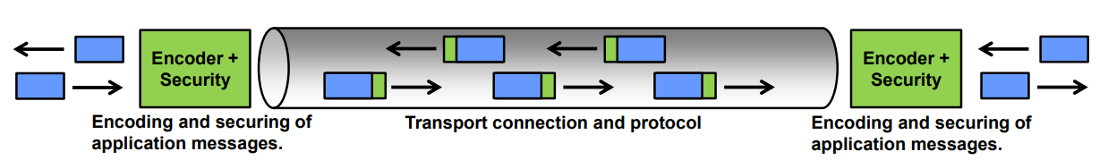
WCF
B = Binding:
The binding defines how a web service endpoint is accessed.
A binding contains the following elements:
Transport protocol:
Underlying transport protocol to use when interacting with the web service.
Examples: TCP, HTTP, MSMQ.
Message encoding:
Definition of the message encoding.
Examples: Text/XML (SOAP), binary, MTOM (Message Transfer Optimized Mechanism).
Security / reliability settings:
Message security settings (e.g. encryption and authentication of message).
Transport security (e.g. encryption of transport connection).
WCF

Slide 9
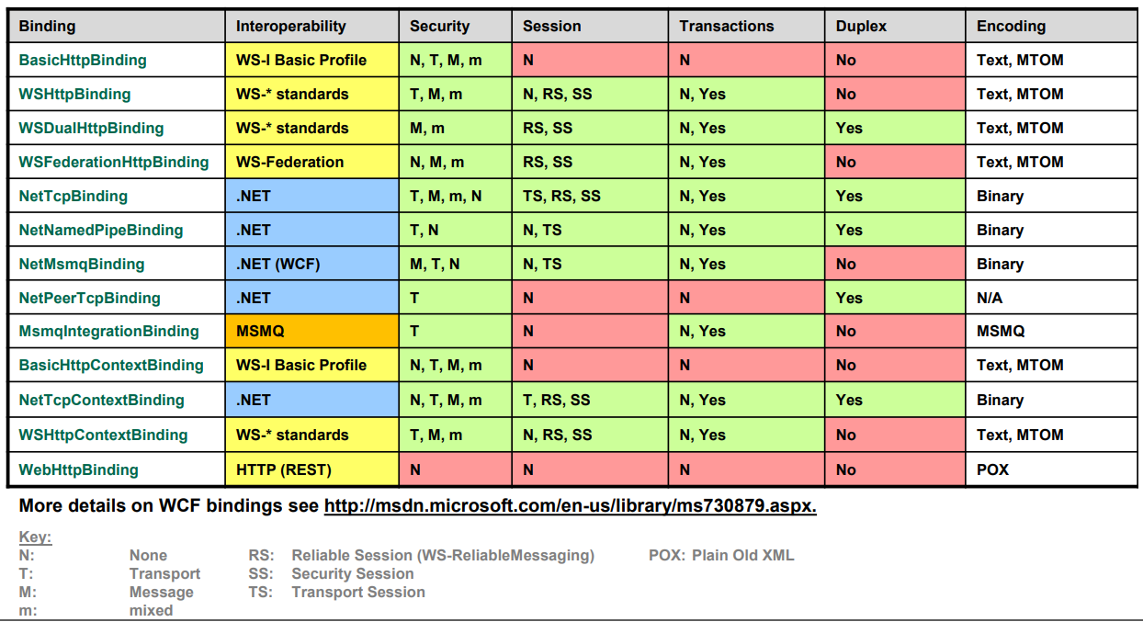
WCF
WCF

Slide 10
WCF
C = Contract:
WCF interfaces are called “contracts” (both client and server must comply with the contract). Contracts describe operations, data structures and messages.
A service contract defines:
Grouping of operations in a service .Net attribute [ServiceContract]
b. Signature of operations .Net attribute [OperationContract]
c. Data types of operations .Net attribute [DataContract]
WCF

Slide 11
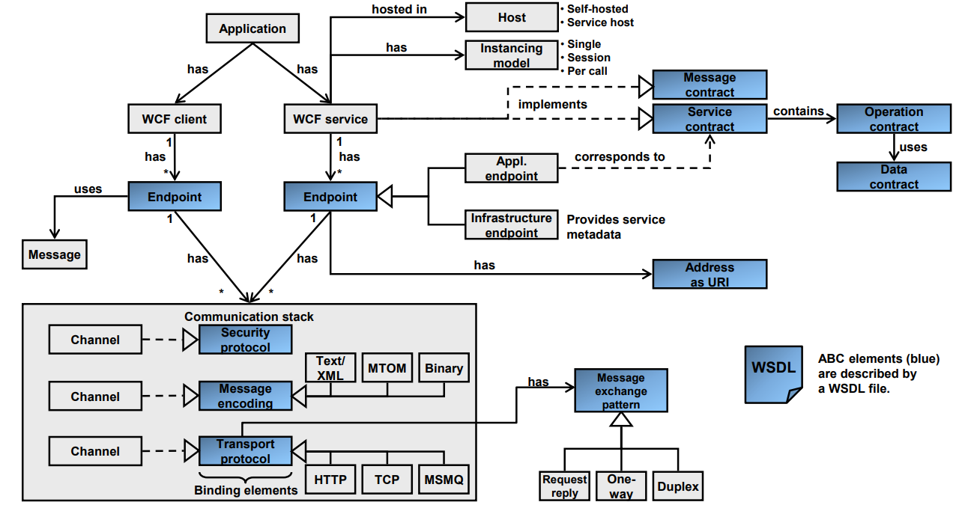
WCF
WCF

Slide 12
WCF
Application: An application has a WCF client and / or WCF service.
WCF client: Component with a WCF endpoint for communicating with a WCF service through messages.
WCF service: Counterpart to WCF client. Runs in its own process (self-hosted) or in a specific service hosting process (IIS, Windows Activation Service, Windows Service).
Endpoint: WCF client and service use an endpoint to connect to each other.
Application endpoint: Endpoint on which an application service is exposed / offered.
Infrastructure endpoint: Part of WCF system to offer metadata of an application service.
Message: Unit of data exchange between WCF client and service. WCF is strictly message-based.
Address: Physical address comprising hostname, port number and service name (=URI). The application service is accessible under such an address
WCF

Slide 13
WCF
Service contract: Set of operations which define the application service. The service contract is implemented by an interface in a .Net language (e.g. C# interface).
Operation contract: Defines the signature (parameters and return type) of an individual operation of a service.
Message contract (SOAP message layout): Describes the format of a message (which information elements should go into the header, which should go into the body, level of security to be applied to message etc.).
Instancing model: Defines how the service is instantiated: Singleton, Session, Single-Call.
Binding (element): Defines how an endpoint communicates with its peer endpoint. Binding elements define individual aspects of the communication, basically the transport protocol (raw TCP, HTTP), message encoding (text, binary) and the security.
Channel: Concrete implementation of a binding element (binding element = configuration, channel = implementation).
WCF

Slide 14
WCF
Transport protocol (transport binding): Defines the protocol used to transfer messages “over the wire” (wire protocol). A common transport protocol is HTTP (HTTP over TCP).
Message encoding (binding element): Defines the formatting of messages before they are sent over the wire (using the transport protocol). Common message encodings are text/XML (SOAP) or MTOM (Message Transmission Optimized Mechanism) for efficient transfer of binary data.
Security protocol (security binding): Defines what security functions (authentication, encryption) are applied to messages.
Message exchange pattern: Defines how messages are exchanged (request-reply, one-way, duplex).
Communication stack: Comprises different binding elements, at a minimum a transport binding element and message encoding binding element.
Host: Runtime environment for a service. Either self-hosted (specific process for service) or a general hosting process, e.g. IIS, WAS or Windows service.
WCF

Slide 15
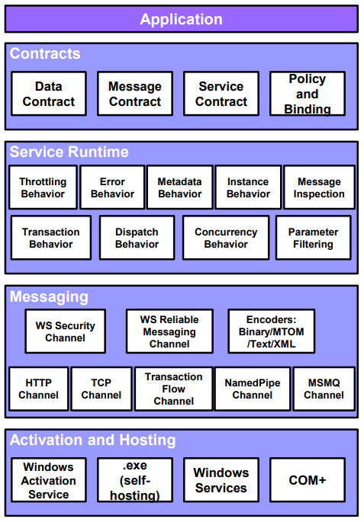
WCF
Contracts define the service (as XSD):
Data contract → Definition of complex types (structures, classes, generics).
Service contract : Definition of operation signatures.
Message contract : Layout of (SOAP) messages.
Policies and binding : Definition of transport protocol (TCP, HTTP) and message encoding (text, binary); security functions used (if any).
WCF
Service runtime contains runtime behavior (functions of service host):
Examples: Error behavior, throttling message reception, delivery of service metadata to the outside world.
Messaging layer with channels (channel = implementation of binding element):
Security (authentication & encryption) & reliability (reliable messaging) channels.
Message encoding channels (text, binary, MTOT, XML).
Transport channels (TCP, HTTP).
Channels, service runtime behaviors and service itself (modules implementing the contracts) are run in a host process. Services can be:
a. Self-hosted (run in their own process).
b. Hosted by an external agent (WAS, IIS, Windows services).

